Slide 1
Performance Tuning FlexIP
Tools and Tips

Slide 2
Performance Tuning FlexIP
Joshua Lilley

Slide 3
Performance Tuning FlexIP
Discussion Outline
Continued
Tools
  Stanley Toolbox
    Firmware Download
    Standalone Test
    Panel Debug
  Mobile App
  Resource Portal
Audio-8 Pro
  Audio Wiring
  Audio Calibration
Access-4 Pro
Troubleshooting IP & Cradlepoint communication
Questions

Slide 4
STANLEY ToolBox

Slide 5
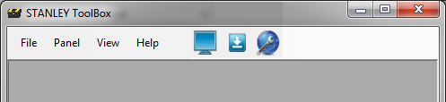

STANLEY ToolBox Overview
About
LAN Firmware Download
Standalone Test
Sonitrol companion application for technicians with Windows PC’s
Common Uses
  Firmware Updates to panel and modules
  Communication Test
  Glass Break Test
  Troubleshooting
    Communications
    Access Control
    Alarm Inputs
    Auxiliary Outputs
    Arming and Disarming
LAN Debug
Advanced Audio Test

Slide 6
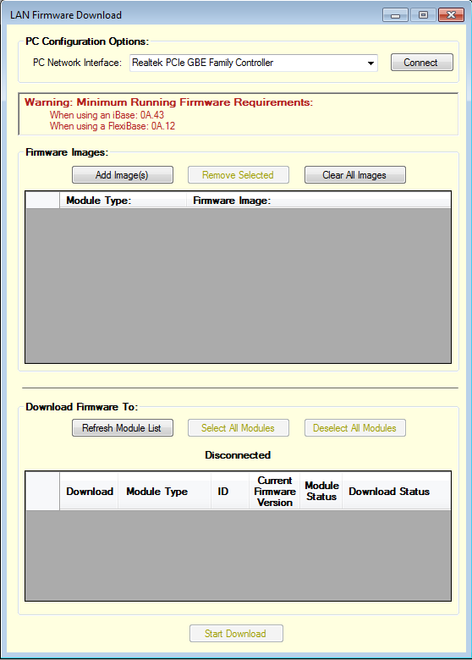
ToolBox - LAN Firmware Download
Using the LAN Firmware Download
Get latest firmware online
  http://resource.sonitrol.com/library/asset/document/firmware-bundle
  Updates often contain performance improvements, and new features
Connect laptop to panel or modules LAN
Select your laptops wired network adapter from the drop-down box, then select the Connect button

Slide 7
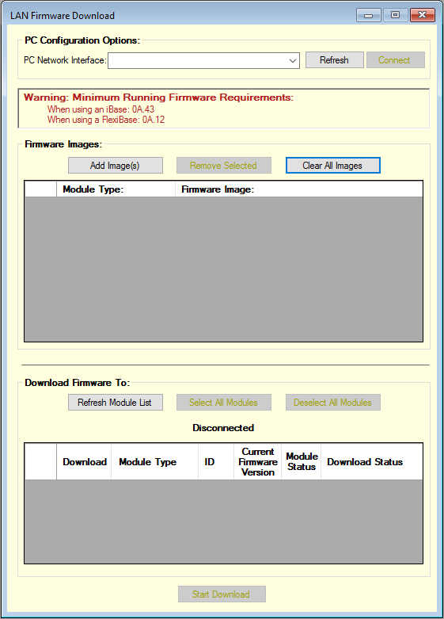
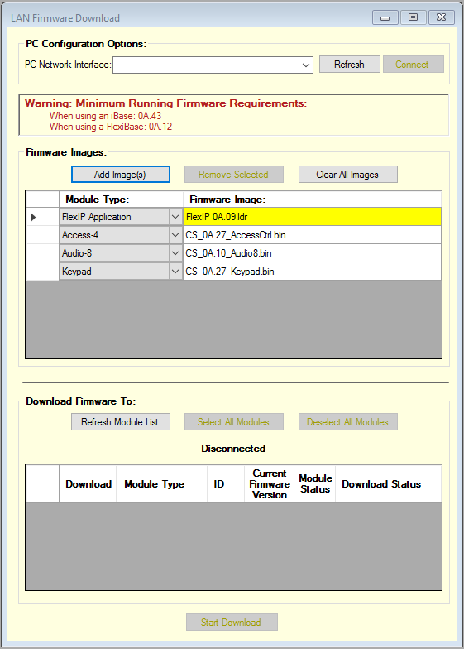
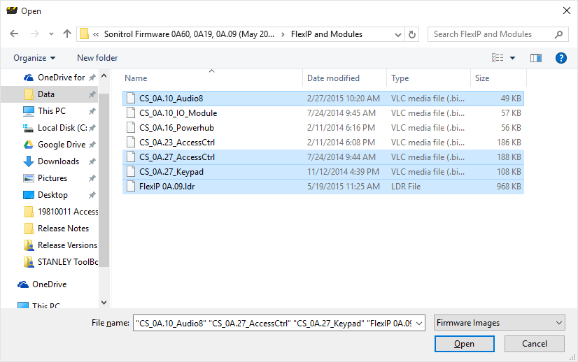
ToolBox - LAN Firmware Download
Add Images
Select the Add Images button and browse to the firmware files saved on your PC
Add images for each device that is on the system
Use the latest versions unless instructed otherwise

Slide 8
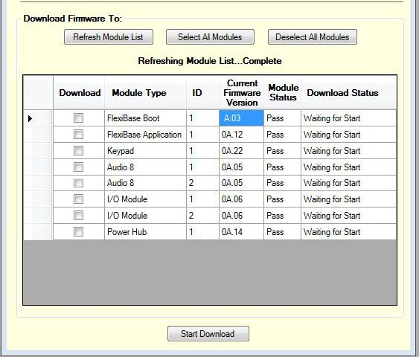
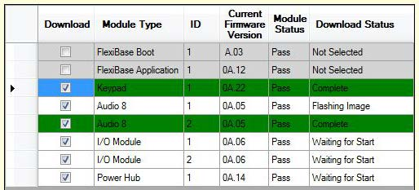
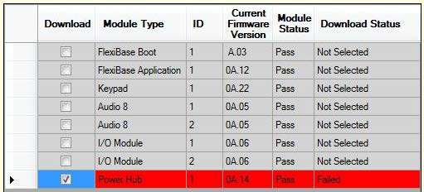
ToolBox - LAN Firmware Download
Select Devices, then Start Download
Devices selected cannot be downloaded unless a version has already been added for that device type using the Add Image(s) button
Select the Start Download button
Successful updates are shown in green
Failed updates are shown in red

Slide 9
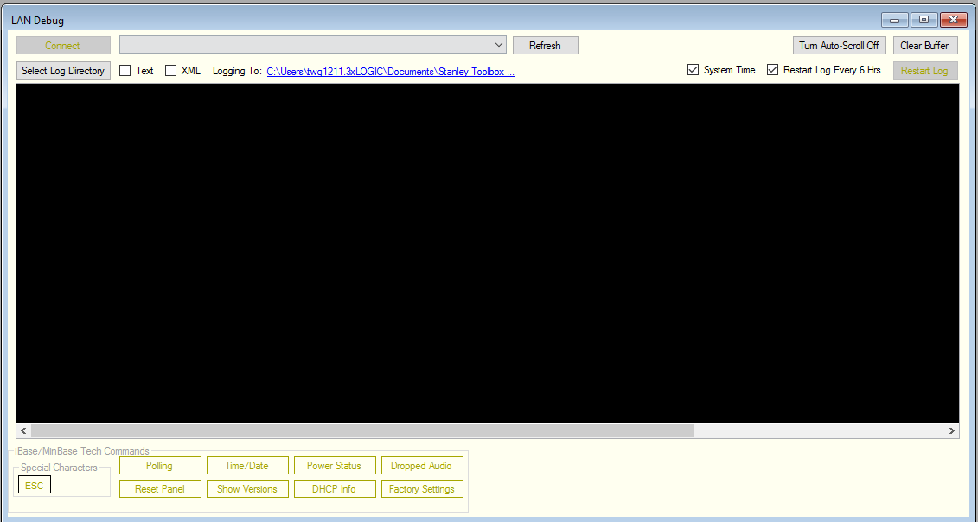
ToolBox – Panel Debug
Turn Auto-Scroll Off to pause the screen to get a better look at events.
Clear Buffer clears all previous data from screen
Using the LAN Debug Window
Connect laptop to panel or modules LAN.
Select your laptops wired network adapter from the drop-down box, then select the Connect button.
Command buttons can be used to assist the technician in several different scenarios.

Slide 10

ToolBox – Panel Debug
Tech Commands
Panel displays its current date/time
Display the panel and bell output power status
Toggles whether module polling messages are displayed, reduces chatter
Displays the current count of dropped audio packets, mostly used by engineering
Reset panel and connected modules to Factory Default options
Reboot the panel
Shows all system firmware versions
Show panel network information, including DHCP Lease and MAC

Slide 11
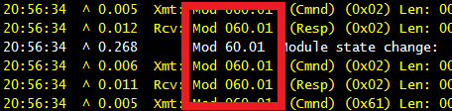
ToolBox – Panel Debug
Interpreting the Data
Device Identifier Key
I/O | 10
iBase OKI | 21
Access-4 | 30
Access-4 Pro | 31
iBase DAS | 41
Audio-8 | 50
Audio-8 Pro | 51
Keypad | 60
Power Hub | 70
Echostream EN4200 | 80
STANLEY ToolBox | 100
Color | Event Type
Purple | Firmware version reported, alarm activation, download from CS
Yellow | Polling messages between panel and modules
White | Communication events (IP and phone), Status messages, download acknowledgments
Blue | Access control events, and iBase internal processor polling
Red | Power, Battery, general error conditions
Green | Audio events, and ARE processor testing
Orange | Clock events
Module/Panel Identifiers
Color coded log events
Log is automatically saved
Device Identifier
Module type and address (Keypad 1 shown here)

Slide 12
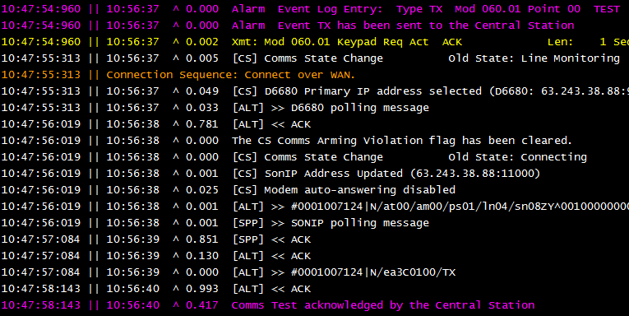
ToolBox – Panel Debug
Log Example: Test Signal
User initiated Keypad Test Signal
Panel establishing IP connection to Central Station using RX IP 1 info
Test signal Acknowledge by Central Station

Slide 13
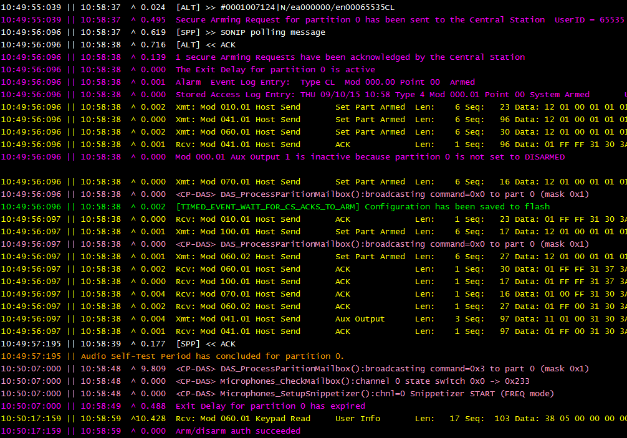
ToolBox – Panel Debug
Log Example: Arming
Arming with code 65535
Arming Successful, begins entry delay timer
Programmable Aux has been de-activated

Slide 14
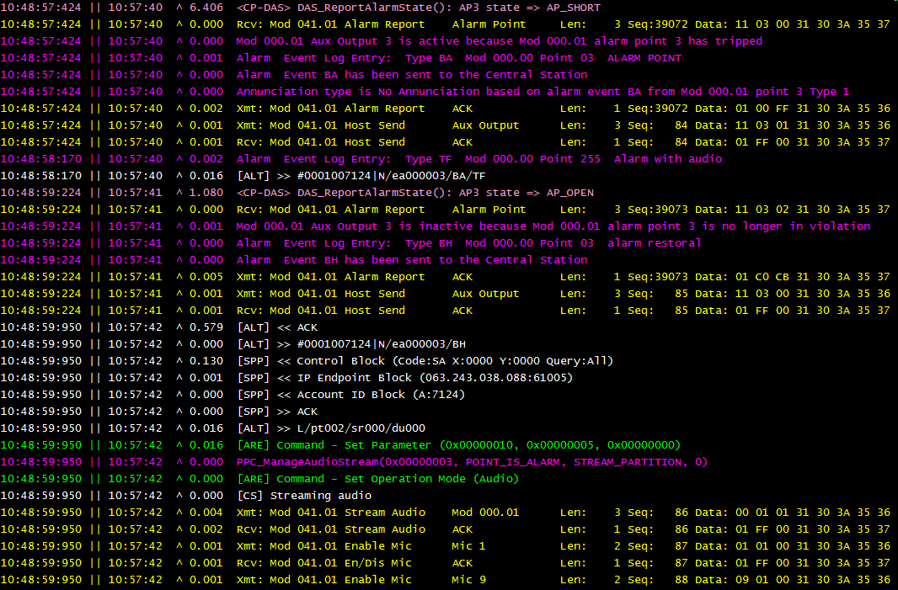
ToolBox – Panel Debug
Log Example: Alarm Point
Alarm Point 3 state changed to Short
Alarm being sent to Central Station
Alarm Point 3 state changed to Open
Established connection to CS
Streaming Audio resulting from alarm violation

Slide 15
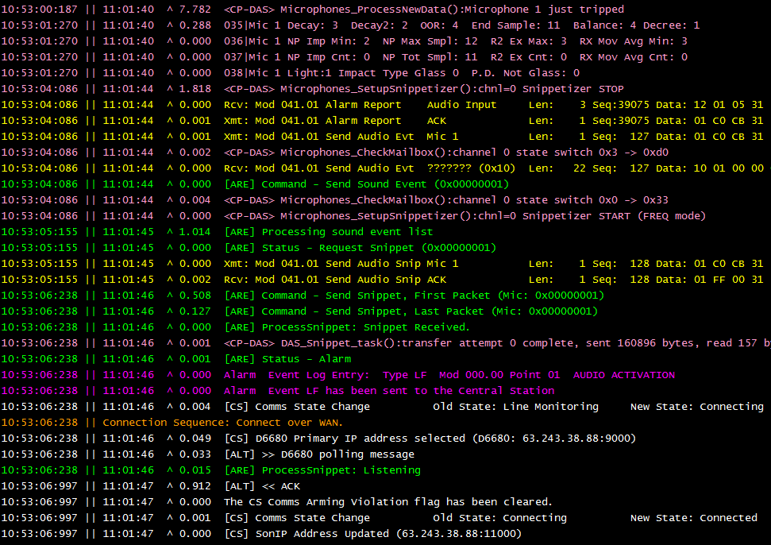
ToolBox – Panel Debug
Log Example: Audio Activation
Audio Detector 1 activated, begins internal audio processing.
Audio Activation event with audio being sent to Central Station.

Slide 16
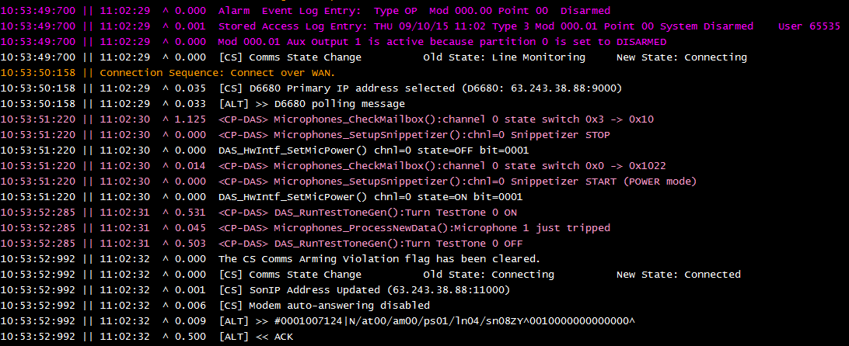
ToolBox – Panel Debug
Log Example: Disarm
Disarmed with code 65535.
Panel begins to establish WAN connection to Central Station to report the Disarm.

Slide 17
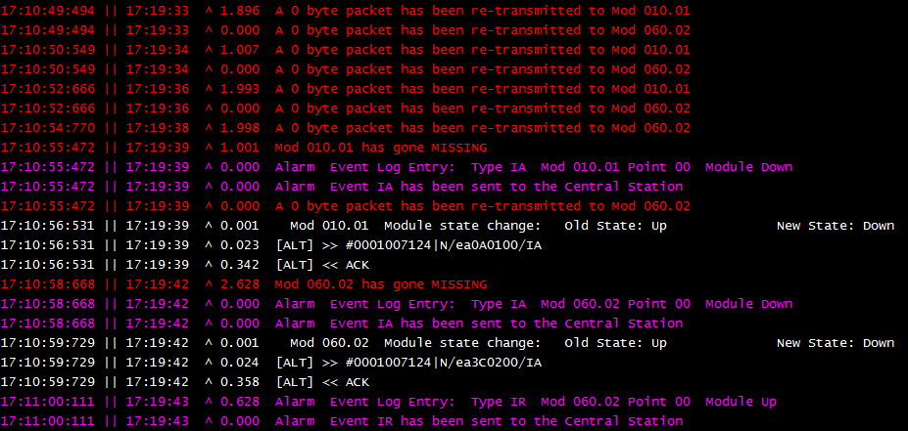
ToolBox – Panel Debug
Log Example: Module Down
  I/O Expansion Module 1 is Down
  Keypad 2 is Down

Slide 18
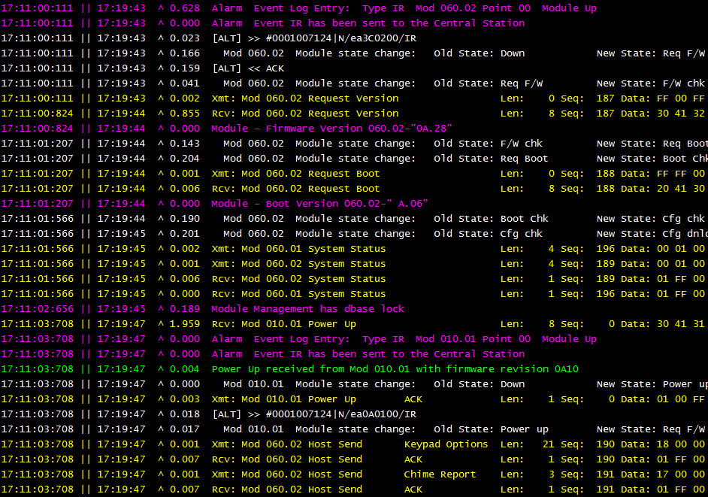
ToolBox – Panel Debug
Log Example: Module Up
  Keypad 2 is Up
  I/O Expansion Module 1 is Up

Slide 19
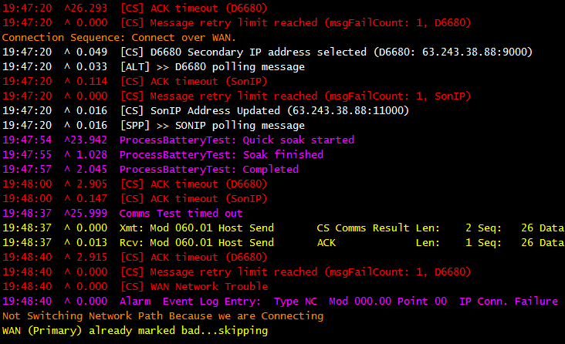
ToolBox – Panel Debug
Log Example: IP Comms Down
  Ack Timeout (failed previous receiver poll)
  Polling Message to receiver (retry since previous Poll failed)
  SONIP Ack Timeout (failed previous poll to SONIP)
  WAN Trouble declared due to consecutive missed Polls
  Panel buffering IP Conn. Failure alarm to send to Central Station

Slide 20
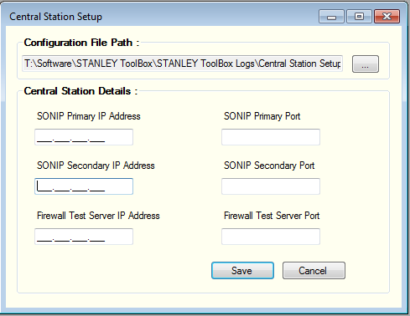
ToolBox – Standalone Test
About
  Fill in blanks with details from Central Station, then Save.
Is a simple network test utility
  Tests network connection from customers site to the CS
  No panel required to run test
  Gives Suggested value for IP Periodic Test (Keep Alive)
Complete the 1 time Central Station Setup
  File > Central Station Setup
  Enter information supplied from your Central Station

Slide 21
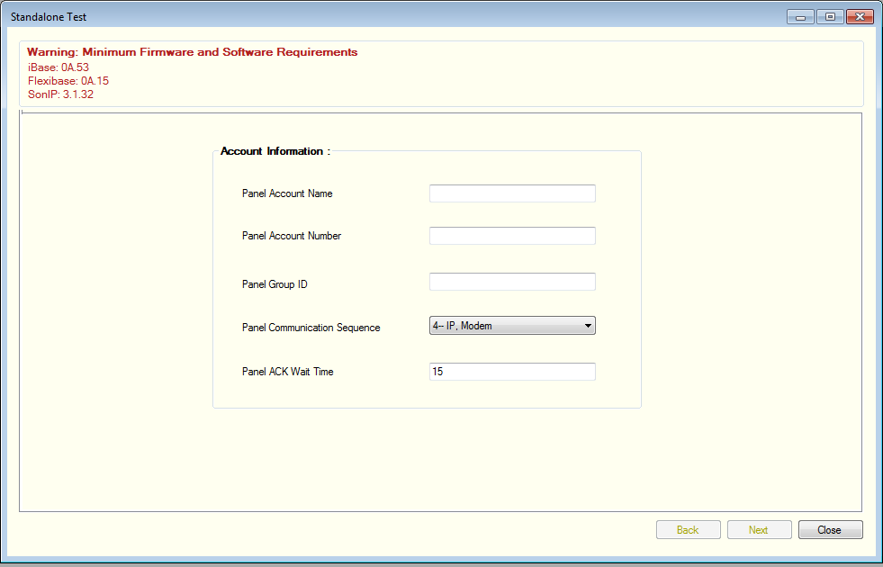
ToolBox – Standalone Test
Account Information
Enter Account Information, then select Next
  This information is used in the report that’s produced at the conclusion of the test

Slide 22
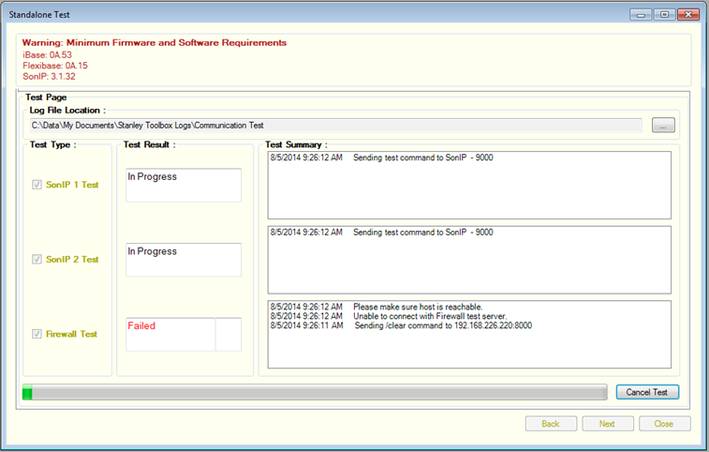
ToolBox – Standalone Test
Begin the Test
Press Start to begin the test
  Each of the 3 tests shows its status
  Retry if needed

Slide 23
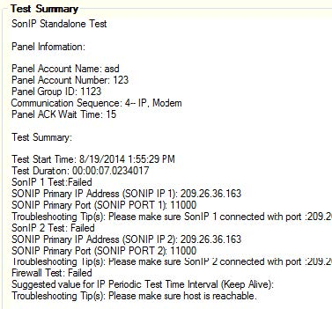
ToolBox – Standalone Test
Results
Press Next to view the Test Summary
  Test Summary is automatically saved to your PC, in the directory that was specified on the previous screen
Suggested value for IP Periodic Test (Keep Alive)

Slide 24
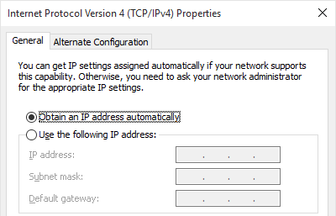
Commonly Asked Questions
Cannot connect to panel with ToolBox?
Verify that Windows has identified the network as either Home or Work (not Public).
Ensure your network adapter is set for DHCP instead of having a pre-configured static address.
Firewall settings may also prevent connection to panel.

Slide 25
IP Troubleshooting

Slide 26
Troubleshooting IP Communication
Review Panel programming
Run Standalone Tester
Verify CS is ready to receive signals
Signals Flowing to CS

Slide 27
Firewall Rules
Plug & Play Subscriber Network Requirements
UDP session time out on the subscriber’s firewall greater than 30 seconds is required for default Plug & Play communications to function properly. If the UDP session time out is less than 30 seconds then the panel must be configured with an IP PER TEST TIMER value of 5 seconds less than the customer’s actual UDP session time out.
Direction | Protocol | Source Port | Destination Port | Destination Address | Purpose
Outbound | UDP | 6100 (FlexIP) 6000 (iBase) | Receiver Port (default= 9000) | Receiver 1 Public IP Address Receiver 2 Public IP Address | Receiver
Outbound | UDP | 7002 | Audio Streaming Port Range | SONIP 1 Public IP Address SONIP 2 Public IP Address | Audio Streaming
Outbound | UDP | 7003 | Plug & Play Port (default= 11000) UDM Port (default= 11500) | SONIP 1 Public IP Address SONIP 2 Public IP Address | PnP Keep Alive, Uploads/Downloads

Slide 28
Firewall Rules
Legacy IP Communications Subscriber Network Requirements
Direction | Protocol | Source Address | Source Port | Destination Address | Destination Port | Purpose
Inbound | UDP | SONIP 1 Public IP Address SONIP 2 Public IP Address | Any | Sonitrol Panel | 7001 - 7002 | Uploads/Downloads and Commands
Outbound | UDP | Sonitrol Panel | 6100 (FlexIP) 6000 (iBase) | Receiver 1 Public IP Address Receiver 2 Public IP Address | Receiver Port (default= 9000) | Receiver
Outbound | UDP | Sonitrol Panel | 7001 – 7002 | SONIP 1 Public IP Address SONIP 2 Public IP Address | Any | Audio Streaming
IP PER. TEST TIMER = 00:00
Disable DHCP
This configuration is often more difficult to deploy from a network appliance perspective, especially so when considering the configuration of inbound NAT policies and port forwarding.

Slide 29
Troubleshooting Cell Communication
Review Panel programming
Run Standalone Tester
Verify using latest Configuration file in Cradle point
Signals Flowing to CS

Slide 30
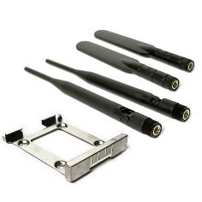
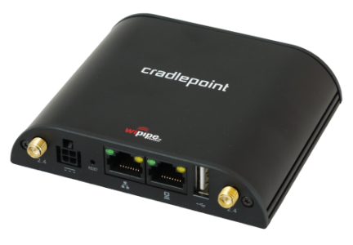
Cradlepoint Install
Requirements
Related Documentation
Cradlepoint IBR600 or IBR650
FlexIP, iBase, or FlexiBase
1.5A @ 12VDC available power
Laptop
Cradlepoint Configuration Files
(download from Resource.Sonitrol.com)
19810075 – Quick Install Guide
19810129 – Ordering Guide

Slide 31
Cradlepoint Install
Pre-Install Signal Strength Check
Router Configuration
Power up the activated IBR router
Use Ethernet cable to connect laptop to LAN port of IBR router
Log into the IBR
  Go to 192.168.0.1
  Default password printed on label on bottom of IBR
Dashboard shows signal status – Connected
System Settings > System Software
‘System Config Save/Restore’ select Upload from file
Browse to ‘192 IBR600 dual LAN.bin
Click the Restore Settings button

Slide 32
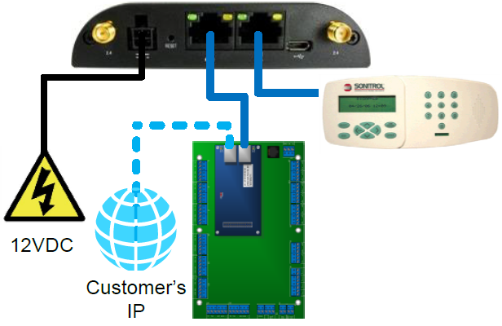
Cradlepoint Install
Connect to Panel – LAN or WAN?
Connect to either LAN or WAN, depending on the panel’s Comm Sequence
  If Cell path is NOT used in a given Comm. Sequence the IBR must operate on the panel’s WAN.
    Enable DHCP in Keypad when on WAN
  If Cell path is used in a given Comm. Sequence the IBR must operate on the panel’s LAN.

Slide 33
Cradlepoint Install
Comm Sequence
Determines the connection type and priority
  If Cell path is NOT used in a given Comm. Sequence the IBR must operate on the panel’s WAN.
  If Cell path is used in a given Comm. Sequence the IBR must operate on the panel’s LAN.
Value | Primary | Secondary | Tertiary
1 (FlexiBase Default) | Modem | None | None
2 (FlexIP Default) | IP | None | None
3 | Modem | IP | None
4 (iBase Default) | IP | Modem | None
5* | IP | Cell | None
6* | IP | Cell | Modem
7* | Cell | None | None
*Sequence only available on FlexIP

Slide 34
Cradlepoint Install
Test
Central Station Reset Panel
Disconnect wired internet and Phone lines if connected
Send a Keypad Test Signal
Arm and Activate Audio
Ensure operator hears clear audio
Central Station Reset Panel, confirm no alarms are reporting
Restore all disconnected communication paths

Slide 35
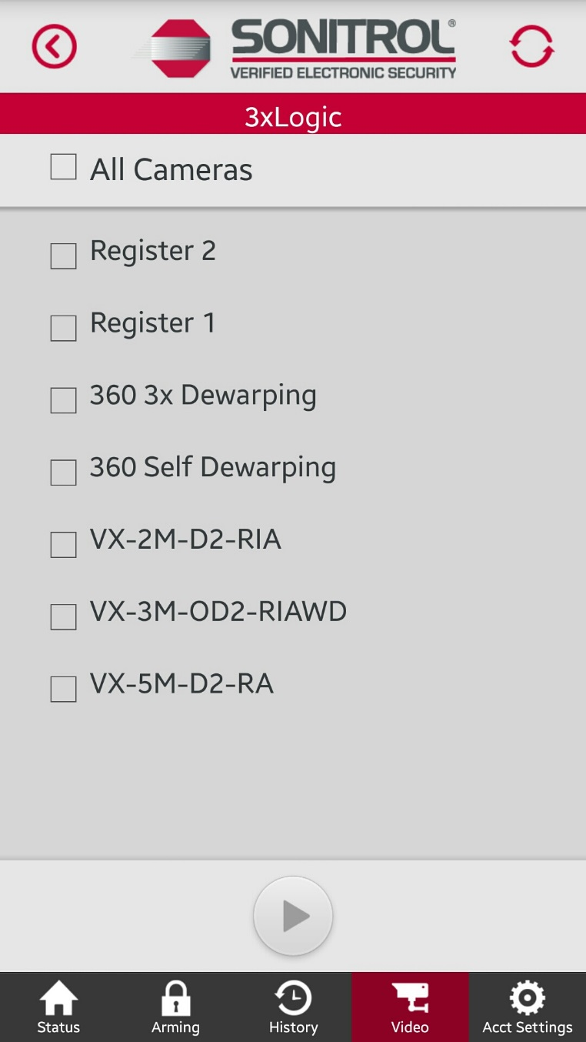
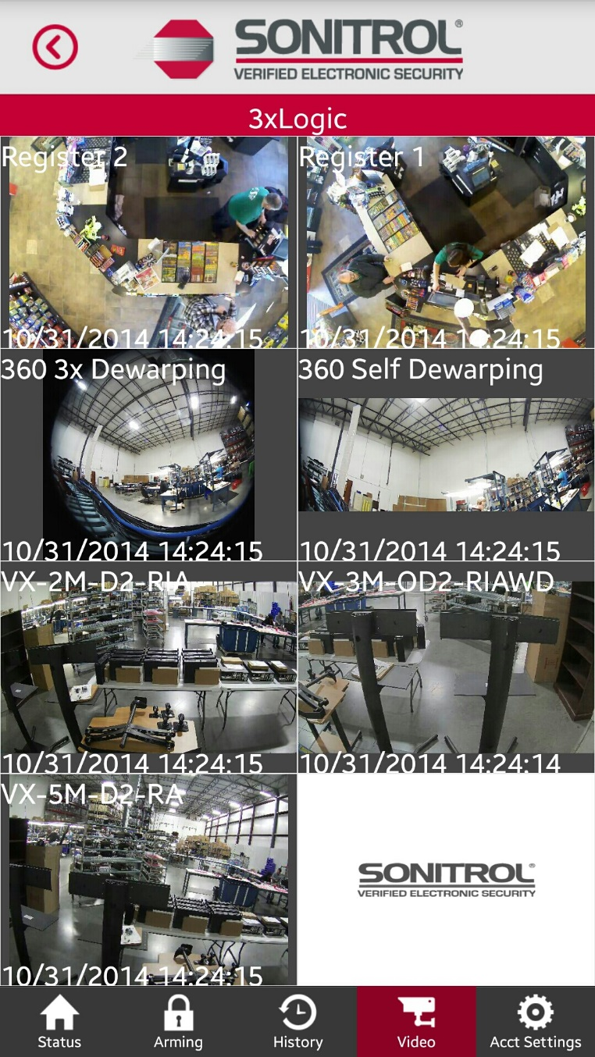
Mobile App
Customer Assistance
Troubleshoot mobile app issues
Show features available to customer
Test video functionality

Slide 36
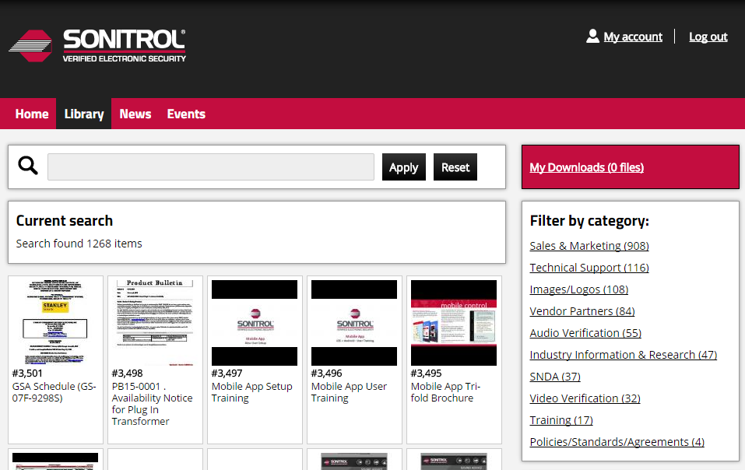
Resource.Sonitrol.com
Register Now
Announcements are sent to subscribers via email.
  New products
  New firmware
  Software updates
  Key Product Bulletins
Download latest
  Install Guides
  Quick Guides
  Firmware Files
  STANLEY ToolBox

Slide 37
New Products

Slide 38
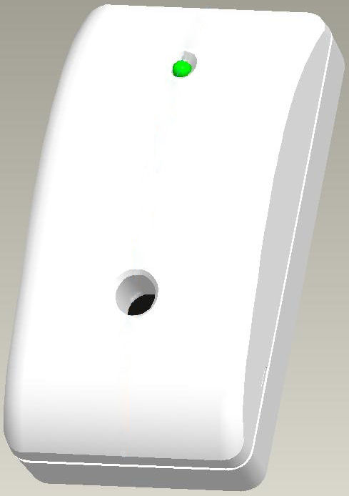
Audio Sensor Enhancements
About
What’s Included
  Alarm Initiator Approval (in progress)
  Terminal Connector Update
  Other Maintenance Updates
Installation Targets
  Save Time
  Eliminate Mistakes
  Standardize on User Codes
  Minimize Service Restarts
  Eliminate Central Station Downtime
  Saves on Service Time when Replacing modules
Audio Sensor

Slide 39
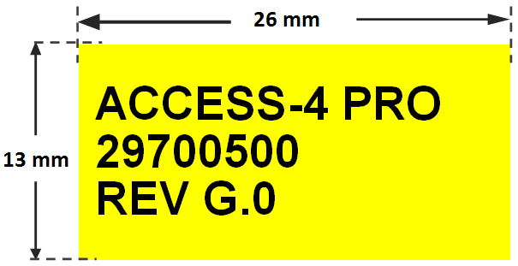
Access-4 Pro Module
About
Replaces Access-4 Module
Same part number in Franchise Store
Same capabilities as Access-4
Additional memory for future enhancements
Different firmware file than Access-4
Compatible with
  FlexIP version 0A.12 and greater
  Access-4
Related Document: PB16-0001
Module Identification
  Silkscreened on corner of PCB between J3 and J17
  Shipped with bright identifier label
Identifying Label on PCB

Slide 40
Audio-8 Pro Module
About
Replaces Audio-8 Module
Same part number in Franchise Store
Additional memory for future enhancements, including Glass Break Analytics (FlexIP systems only)
Different firmware file than Audio-8
Compatible with
  FlexIP version 0A.12 and greater
  Audio-8
Related Documents: PB15-0011 and PB15-0013
Module Identification
  Silkscreened on corner of PCB between J5 and J6
  Shipped with bright identifier label
Identifying Label on PCB

Slide 41
Audio Sensor
Glass Break Enabled Setup and Troubleshooting

Slide 42


Audio Sensor
Mounting with Glass Break Enabled
Top View
Side View
Always face protected glass
8-10’ from the ground, not exceeding 13’
At least 1’ away from corners
25’
25’
Aimed at Center of Glass
25’
~10’
25’
Maximum Coverage Pattern for Glass Break Analytics

Slide 43
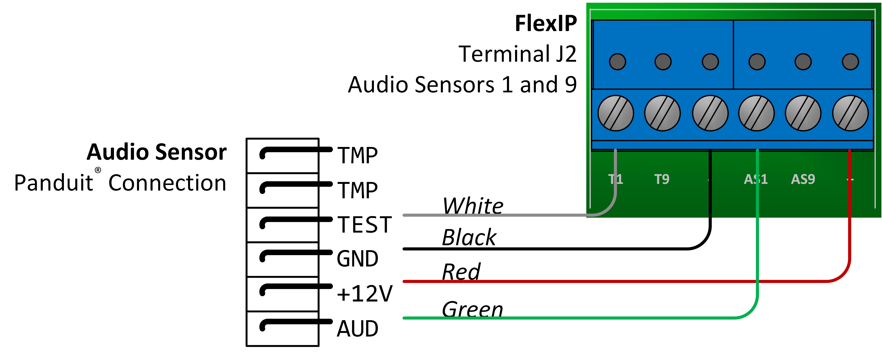
Audio Sensor
Wiring Details
Wire Type | 22AWG stranded
Maximum Wire Length | 1000 ft.
Terminal Type | Audio Sensor: Panduit® FlexIP and Audio-8 Pro: Screw Terminal
Red | +12V DC
Black | Ground
Green | Audio
White | Self-test. A test tone is emitted during arming and walk tests to verify that the Audio Sensor’s listening capabilities are properly functioning.
Tamper | TMP terminals on Audio Sensor may be connected to any available, alarm input on the system. Normally Closed.

Slide 44
Troubleshooting Audio Sensor
Check Power
Listen for Test Tone
Verify Wiring at the Panel
Replace Audio Sensor
Listen to Audio with Buttset

Slide 45


