Slide 1
Ready, Set, FlexIP
Installing a Sonitrol FlexIP Panel

Slide 2
Ready, Set, FlexIP
Joshua Lilley

Slide 3
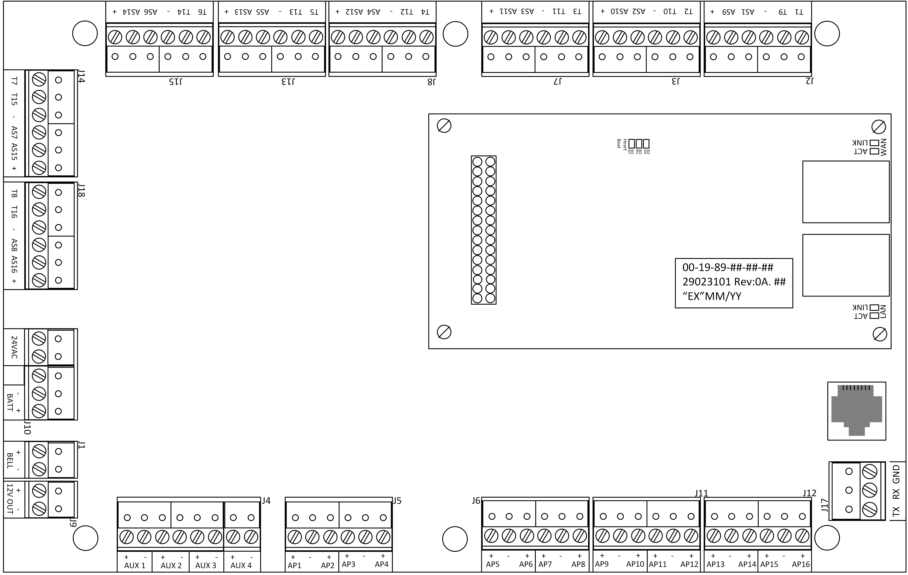
Ready, Set, FlexIP
Overview
FlexIP Capacity
FlexIP Communication
Panel Enclosures
Retrofit Back-Plate
Glass Break Analytics
  Tester Tools
Questions

Slide 4
FlexIP - Updated System Capacity
Firmware Version 0A.15 increases capacity
Minimum Requirements
Expand the capacity of ANY FlexIP system with a simple firmware update
FlexIP 0A.15
Keypad 0A.29
Audio-8 Pro 0A.05
Audio-8 0A.11
Access-4 Pro 0A.04
Access-4 0A.29
I/O Expansion 0A.13
Power Hub 0A.17
SONIP Central Station 3.2.12
STANLEY ToolBox 4.0
Property | Previously | New (Matches iBase)
Max Users | 10,000 | 20,000
Partitions | 8 | 16
Audio-8 Pro / Audio-8 Modules | 8 | 16
I/O Expansion Modules | 8 | 16
Keypads | 8 | 16
Power Hubs | 8 | 16
Access-4 Pro / Access-4 Modules | 4 | 16

Slide 5
Customer to Central Station Data Flow
Wire Panel
Gather information
Program Keypad
Download Data from CS

Slide 6
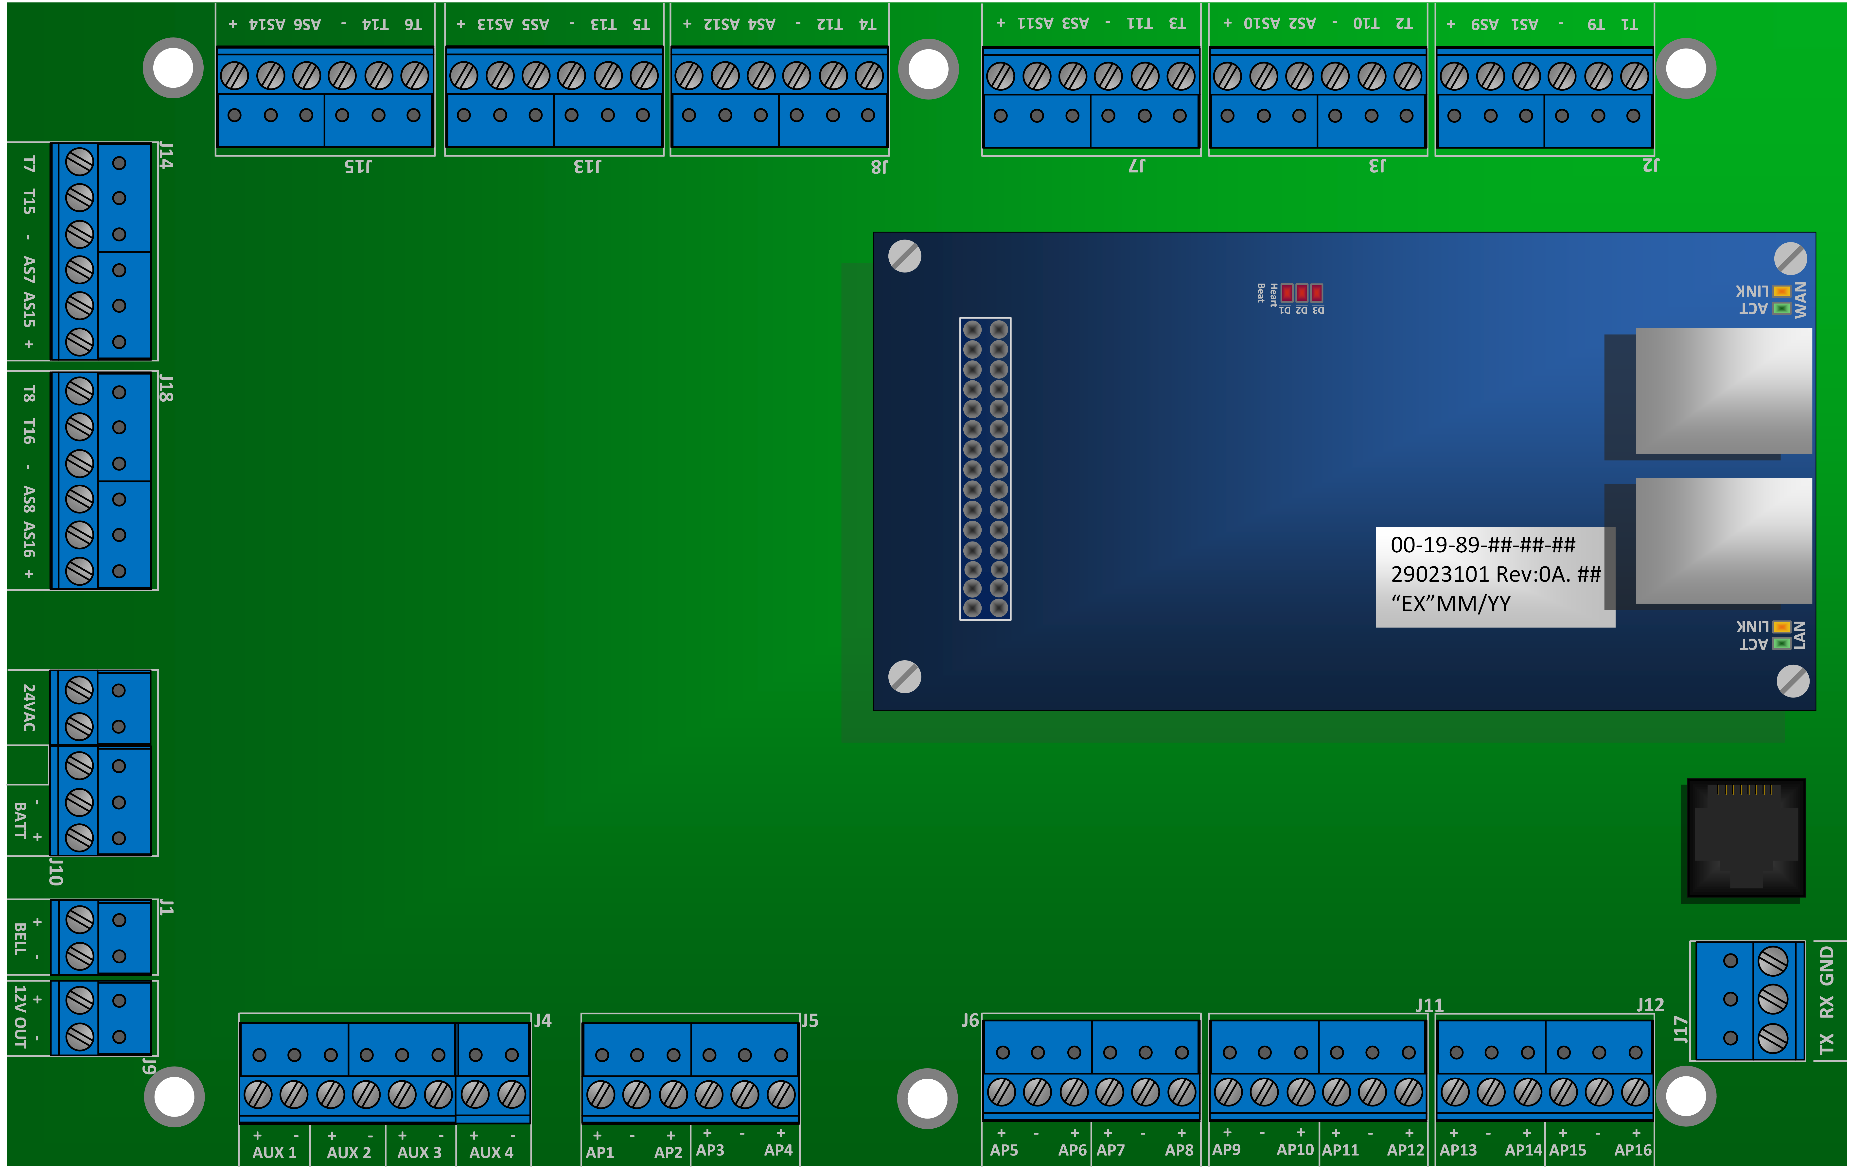
FlexIP Communication
WAN
LAN
(Module communications)
Modem
Notes:
What path am I going to use?

Slide 7
FlexIP Communication
Info from Central Station
Info to obtain from Customer
Panel Account Number
Panel Group Number
NNC Number
Receiver IP Primary & Secondary
Receiver Port Primary & Secondary
SONIP Address Primary & Secondary
If customer does NOT want DHCP enabled:
  Local IPv4 Address
  Local Subnet
  Local Gateway

Slide 8
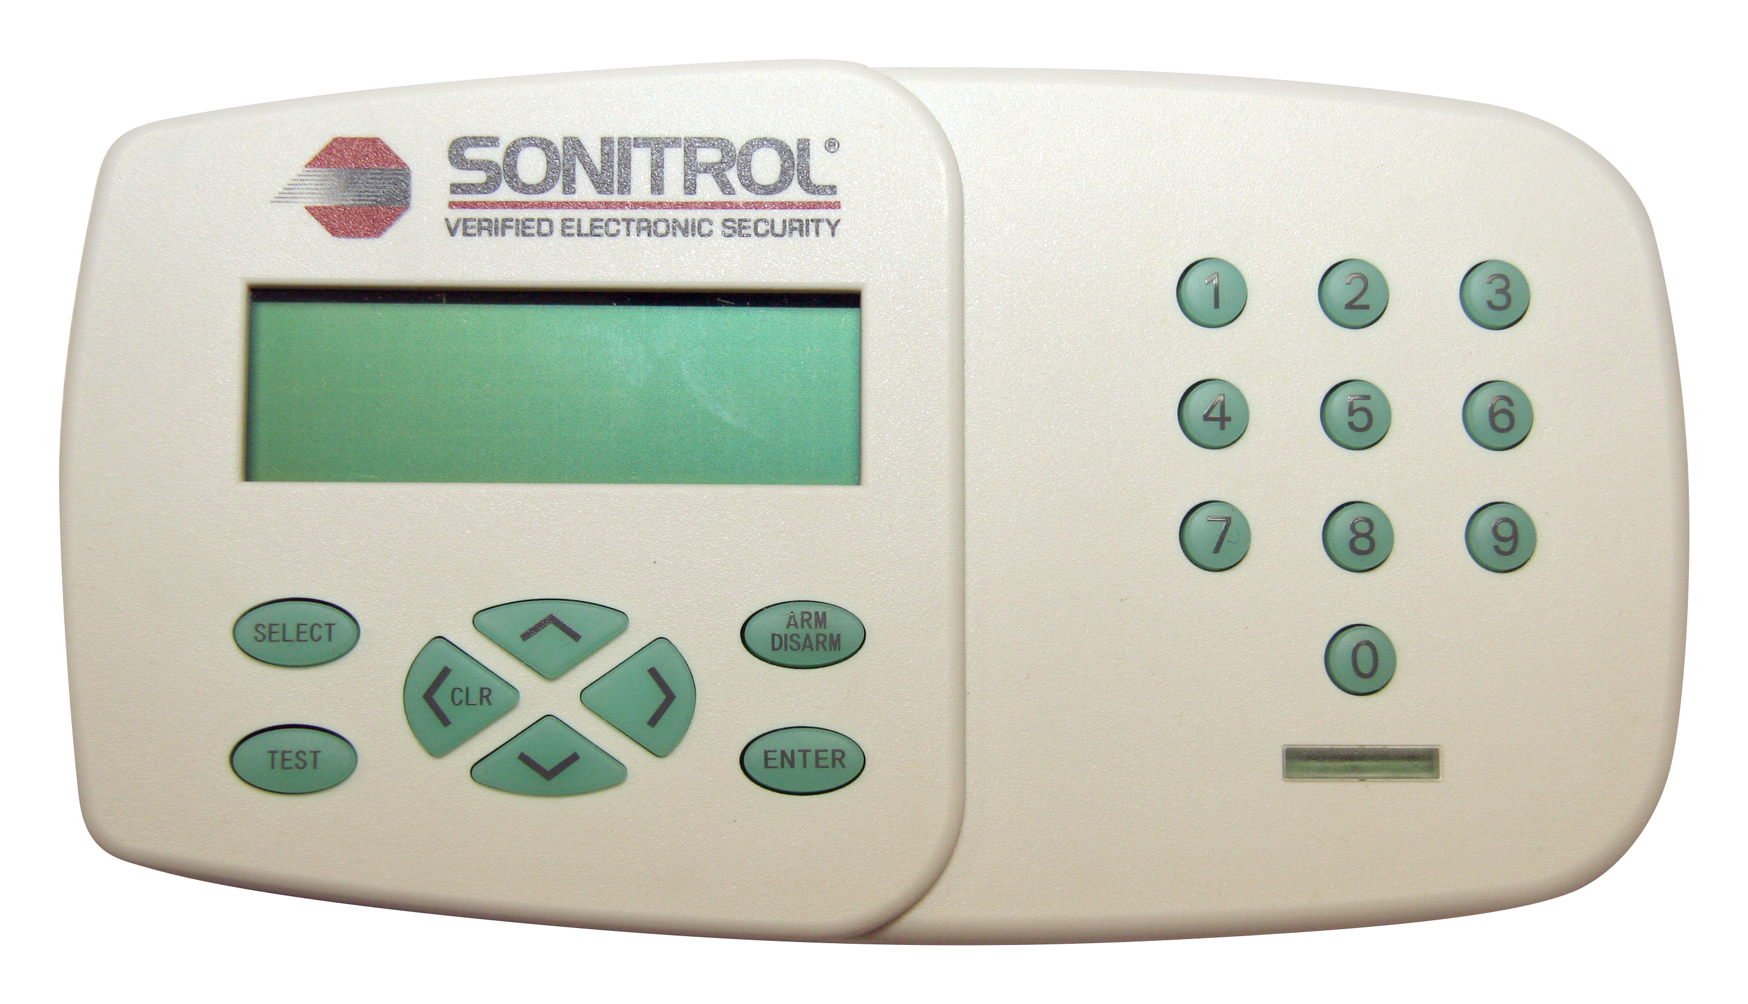
FlexIP Communication
Programming Options using the Keypad
System Menus > Programming Mode > Comms Info

Slide 9
FlexIP Communication
Comm Sequence
Determines the connection type and priority
Value | Primary | Secondary | Tertiary
1 (FlexiBase Default) | Modem | None | None
2 (FlexIP Default) | IP | None | None
3 | Modem | IP | None
4 (iBase Default) | IP | Modem | None
5 | IP | Cell | None
6 | IP | Cell | Modem
7 | Cell | None | None

Slide 10
FlexIP Communication
Programming Options using the Keypad
System Menus > Programming Mode > Comms Info

Slide 11
FlexIP Communication
Programming Options using the Keypad
System Menus > Programming Mode > Comms Info

Slide 12

FlexIP Communication
Recommended Polling Frequency & Ack Wait
Using Recommended values helps minimize avoidable IP Panel communication errors
Related Document: PB14-0018
Best IP Panel Settings (in SONIP) | Wired Internet good connection | Wired Internet poor connection | Cradlepoint Cell strong reception | Cradlepoint Cell poor reception
Polling Frequency (seconds) | 75 | 225 | 75 | 225
Ack Wait (seconds) | 15 | 15 | 40 | 40

Slide 13
Enclosures

Slide 14
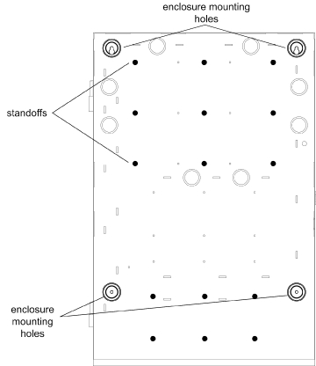
Enclosures
Enclosure Types
  Enclosure selection is determined by modules, power requirement, and environmental concerns
Large
  27” Enclosure
  27” Attack Enclosure
Small
  18” Enclosure
  18” Attack Enclosure

Slide 15
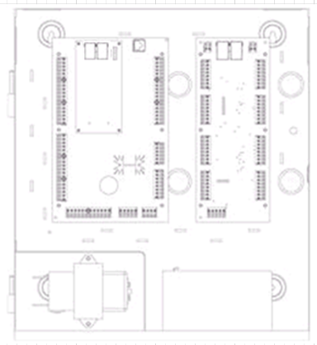
Sample Enclosure Configurations
Large Enclosure 27”
Small Enclosure 18”
FlexIP with (1) Access-4 and (2) Audio-8 Modules
FlexIP with (1) Access-4, (1) Audio-8 module, (1) transformer + battery
FlexIP with (1) Audio-8 module, (1) transformer + battery

Slide 16
Retrofit Back-Plate
Use Existing Sonitrol Plus Enclosure for FlexIP
Upgrade a Legacy Sonitrol Plus System to FlexIP without replacing the installed enclosure(s).
All current generation Sonitrol module(s) are also supported.
Saves time and money.

Slide 17
Glass Break Analytics

Slide 18
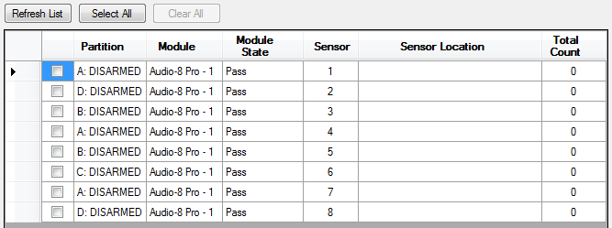
Glass Break Analytics Testing
Advanced Audio Test
New utility built into the STANLEY ToolBox 4.0
Uses LAN connection to FlexIP system
Identified Audio Sensors with Glass Break enabled
Use a Glass Break Simulator tool to trip while test is in progress

Slide 19
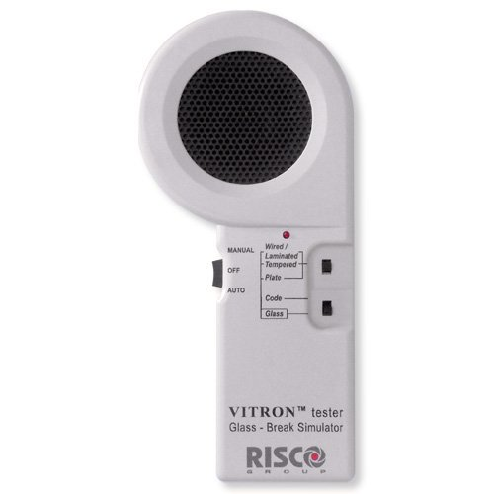
Advanced Audio Test
Requirements
FlexIP system
Sensor is on FlexIP, or on Audio-8 Pro Module (while connected to FlexIP)
Approved Glass Break Testers:
RISCO VITRON Glass Break Tester (RG65)
Interlogix Sentrol 5709C
Tester must be in Glass Mode
RISCO VITRON Glass Break Tester (RG65)

Slide 20
Advanced Audio Test
Quiet… Test in Progress
Ensure area is quiet before testing
Activate Glass Break Tester Glass sound near glass, aimed at sensor
Audio Sensor LED will power off for 2 seconds upon successful test
Repeat for each Sensor being tested
Review results in ToolBox when complete.
RISCO VITRON Glass Break Tester (RG65)

Slide 21
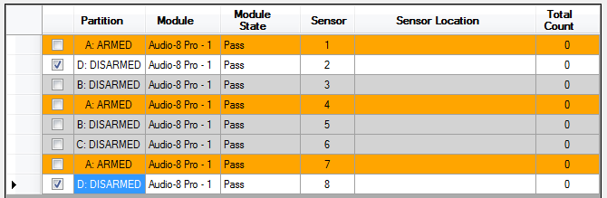
Advanced Audio Test
Review the Results
Sensors that were tripped will be highlighted in green.
Sensors in Armed Partitions that could not be tested are highlighted in orange
Save the log of the test for your records.

Slide 22

Glass Break Test
Glass Break Test Passed
A status event that is automatically sent to the Central Station in real time upon a successful test of a Glass Break enabled sensor

Slide 23
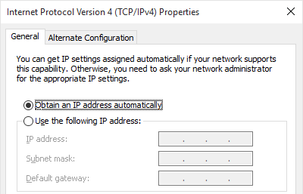
Commonly Asked Questions
Cannot connect to panel with ToolBox?
Verify that Windows has identified the network as either Home or Work (not Public).
Ensure your network adapter is set for DHCP instead of having a pre-configured static address.
Firewall settings may also prevent connection to panel.

Slide 24


